Slide 1
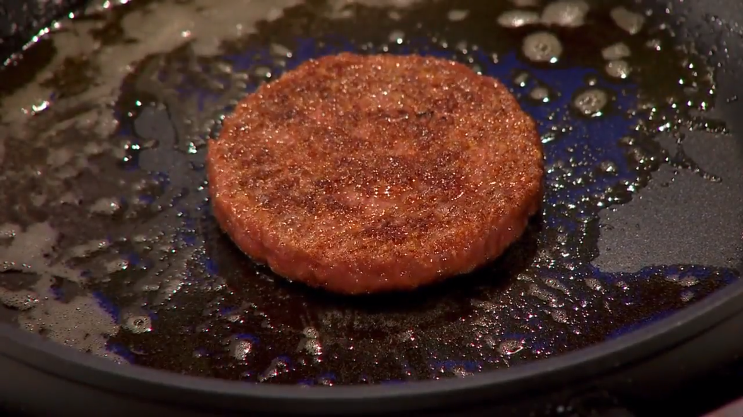
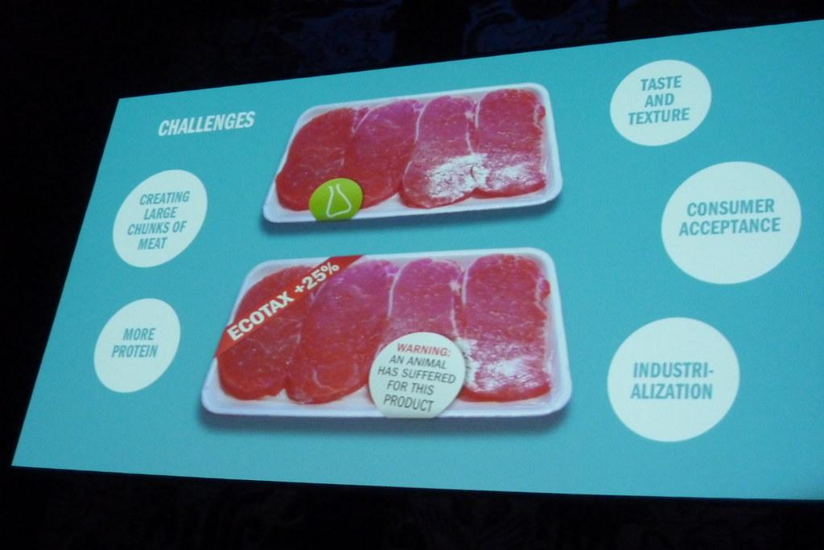

Cultured Meat
Emerging Technology
By: Ryan Li

Slide 2
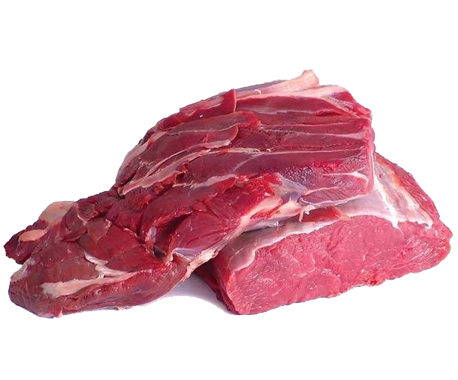

Overview
-History (Slide 3)
-Plan and Implementation (Slide 4)
-Pros (Slide 5)
-Cons (Slide 6)
-Summary (Slide 9)
-References (Slide 10)

Slide 3
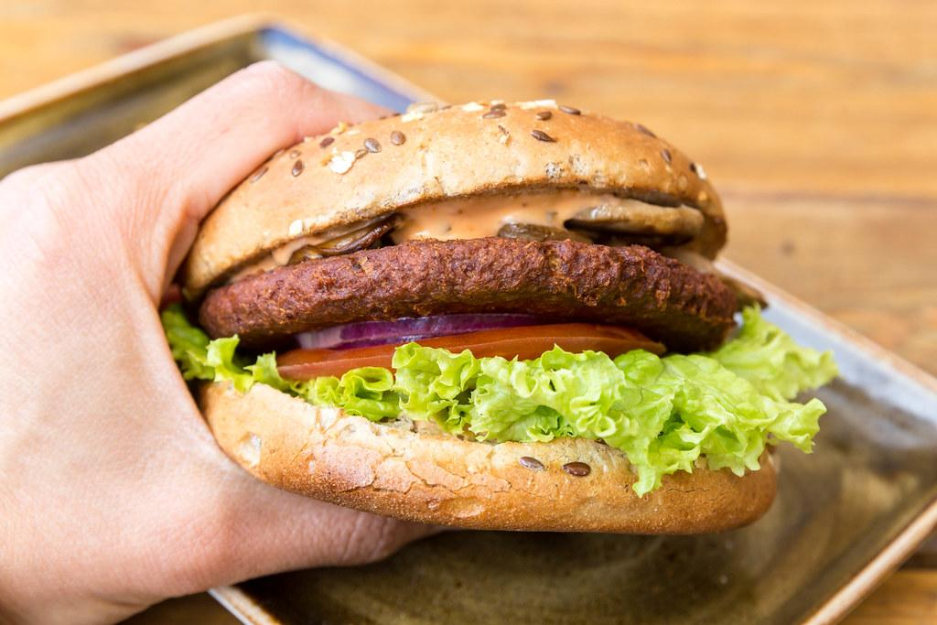
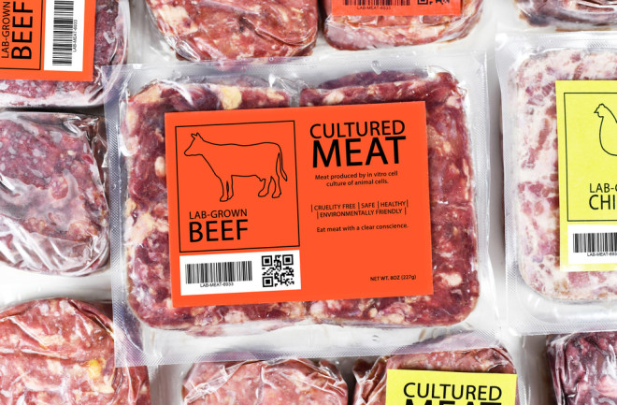
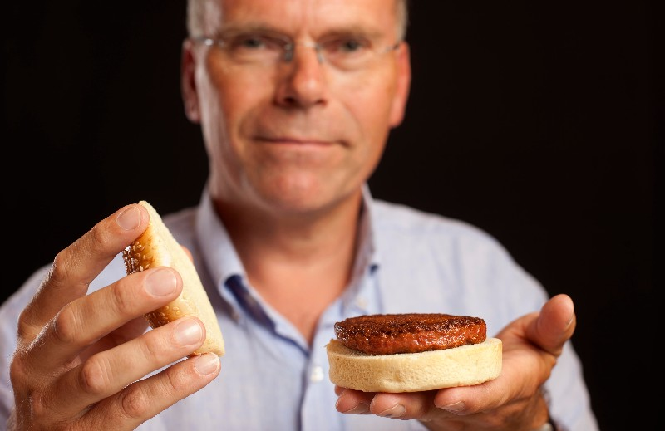
History
-Cultured meat is the harvesting of cells from a living animal to cultivate and grow into meat. In short, lab-grown meat harvested from a few animal cells.
-Cultured meat (a.k.a cultivated meat) was first popularized and made aware of in the early 2000s
-Created to get the same feel and flavor as real meat but without environmental impacts or animal cruelty.
-In 2013, Dutch scientist Mark Post created the first ever cultivated meat burger on live T.V.
-The world’s first ever commercial sale of cultured-meat occurred in December of 2020 in Singapore.

Slide 4

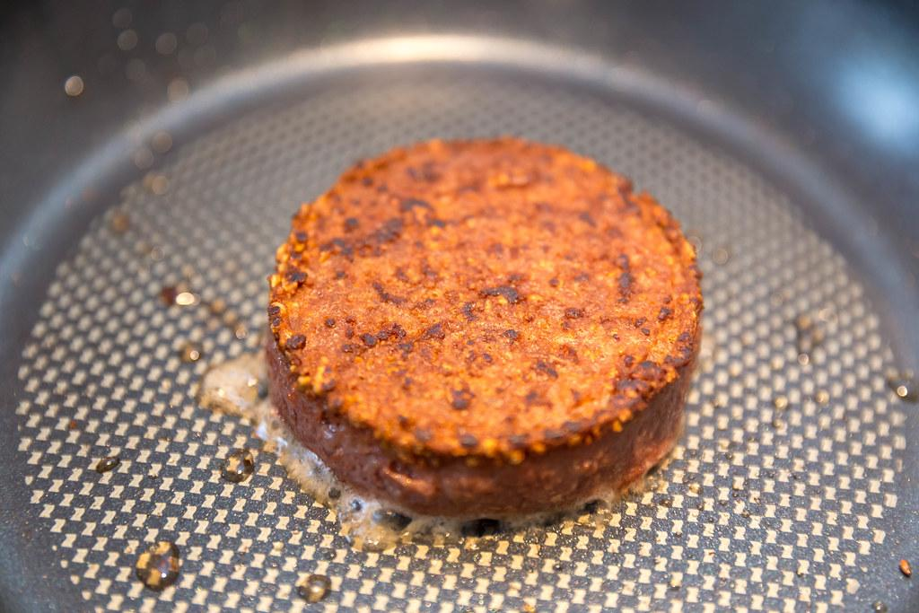
Plan and Implementation
-Cultured meat is planned to be produced at a global scale and to produce more different variety products.
-Cultured meat can help slow climate change and is a more humane method of obtaining meat.
-Some companies plan to mix cultured meat with plant-based products, while others want to make different ingredients out of cultured meat such as fats.
-Even though cultured meat is technically still meat (therefore non-vegan), its main appeal is for omnivores that are worried about the ethics of where meat usually comes from.
Notes:
Planned to be sold globally and used in restaurants all over. Still kind of expensive now, but price will hopefully become cheaper. Cultured meat appeals most to meat-eaters that enjoy meat, but are worried about how the meat is obtained or any potential downsides to health.

Slide 5

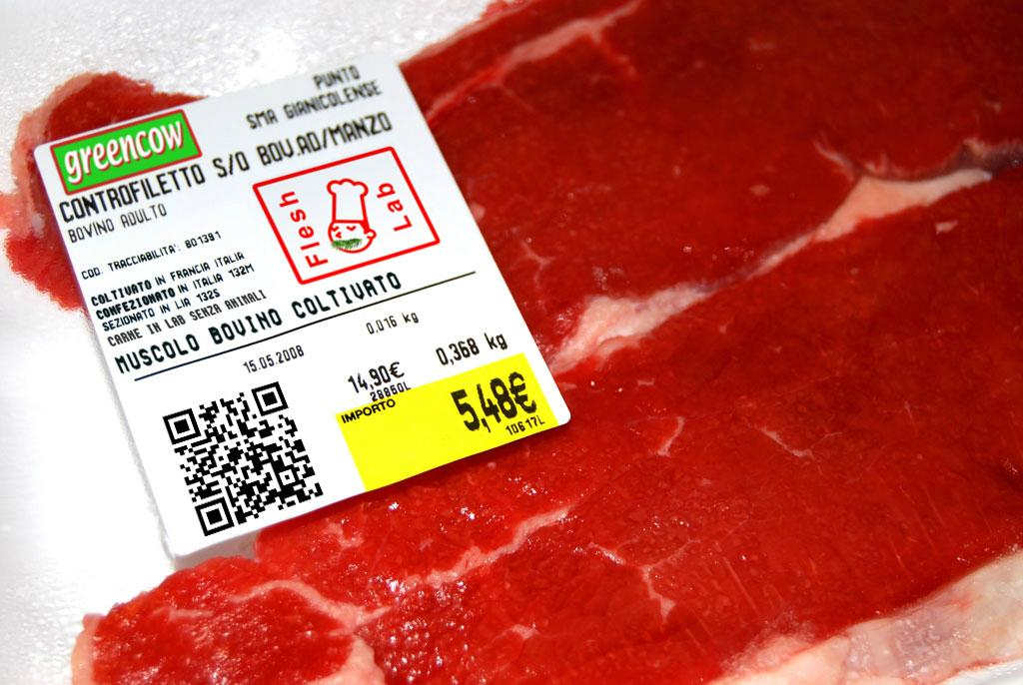

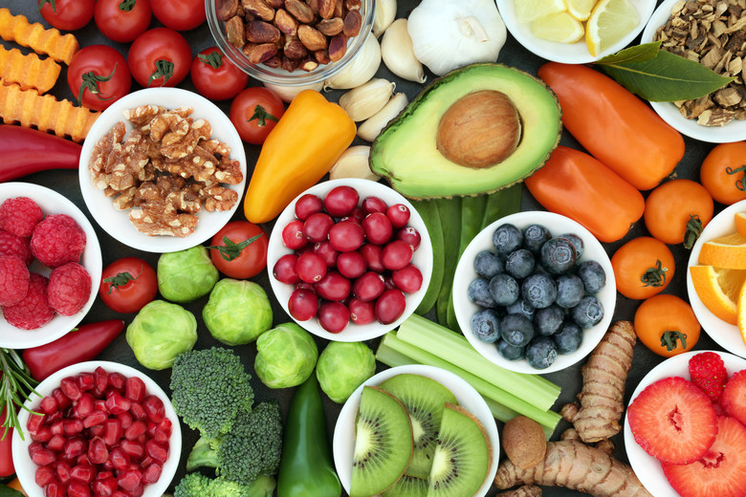
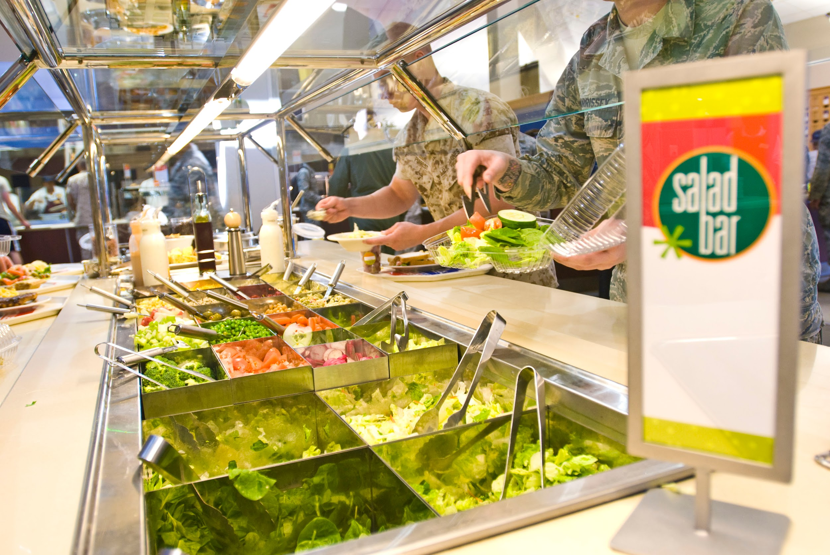

Pros
-Environmentally friendly
-Reduced animal cruelty
-Healthier
-Increased access to food
-More sustainable
-Production of meat
Notes:
Mostly a cleaner, sustainable, healthier way to make meat. Keeping up with meta demand without the usual cons.

Slide 6
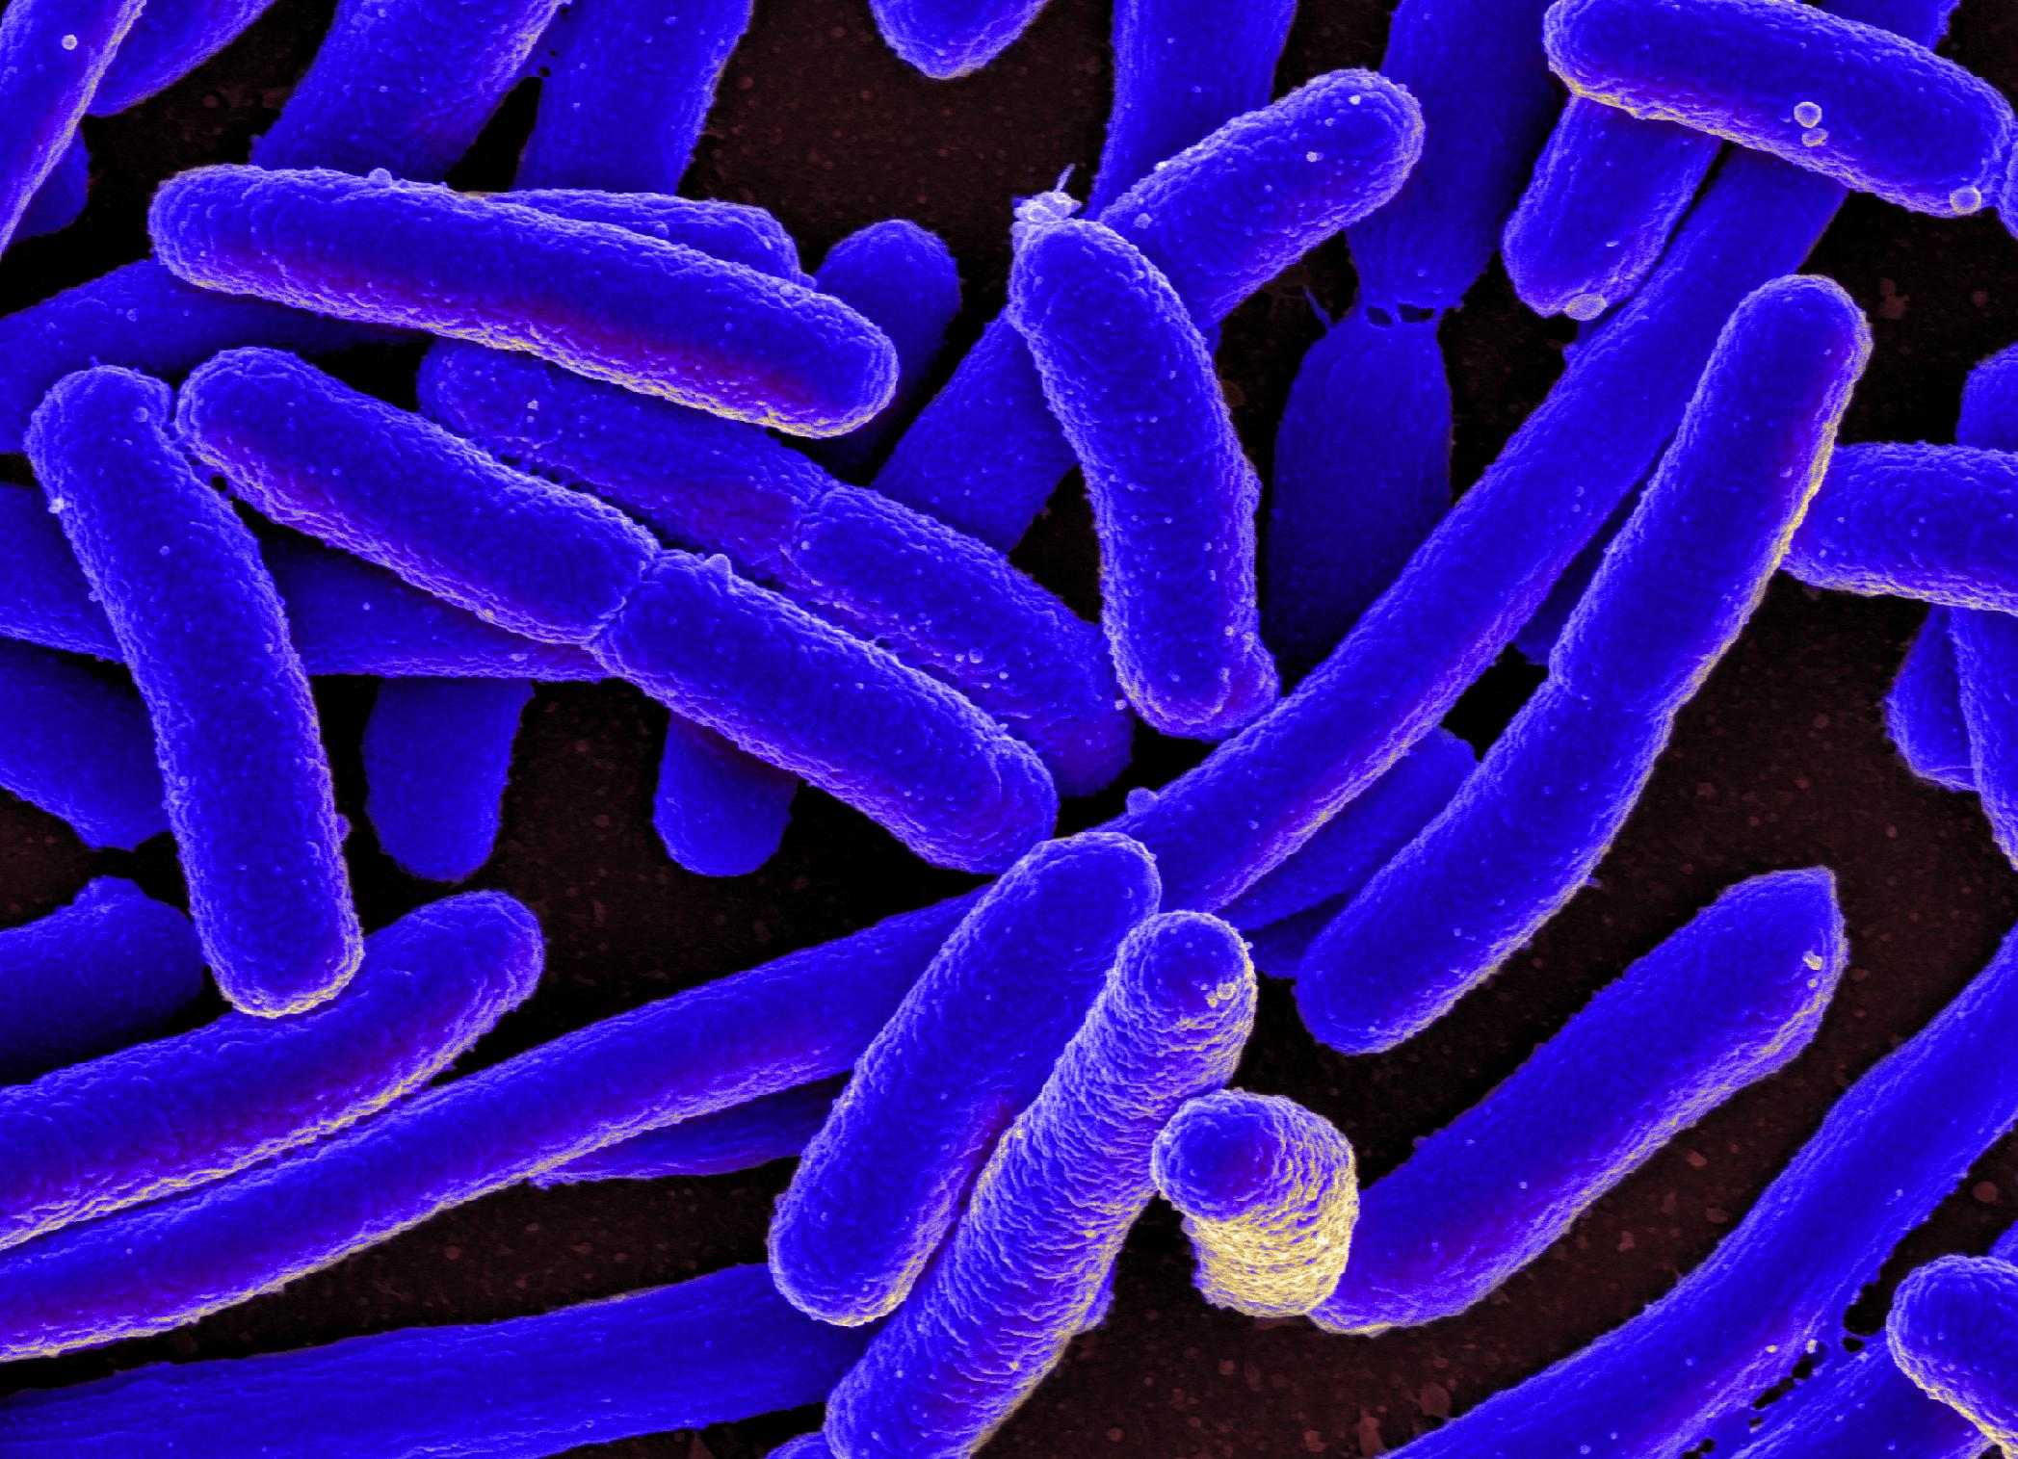



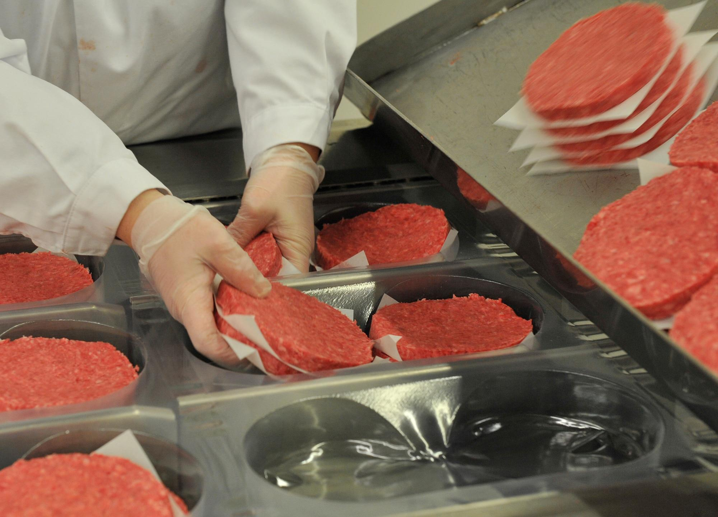
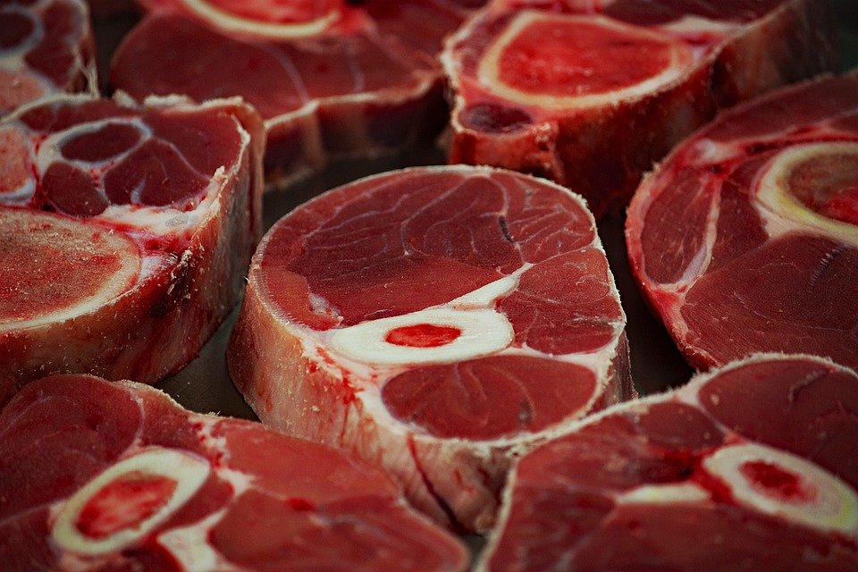
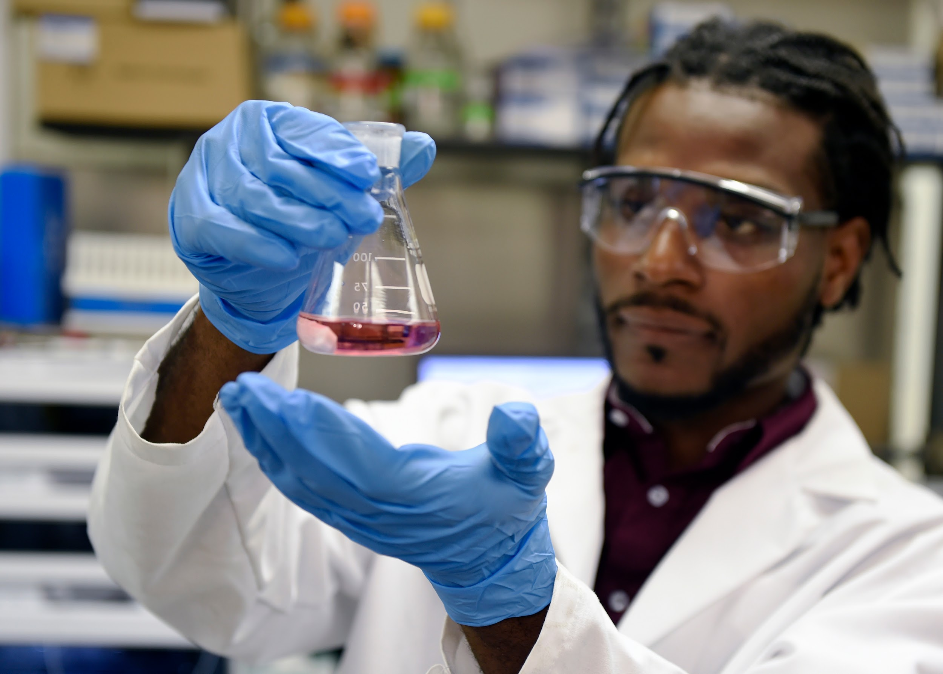

Cons
-Too much time
-Very expensive to produce
-Risk of contamination/hard to regulate
-Still meat (for vegans and vegetarians)
-Same problems as real meat (High cholesterol)
-Still being researched
Notes:
Main problem is that lab-grown meat is still being researched and we can’t be sure about the qualities quite yet.

Slide 7
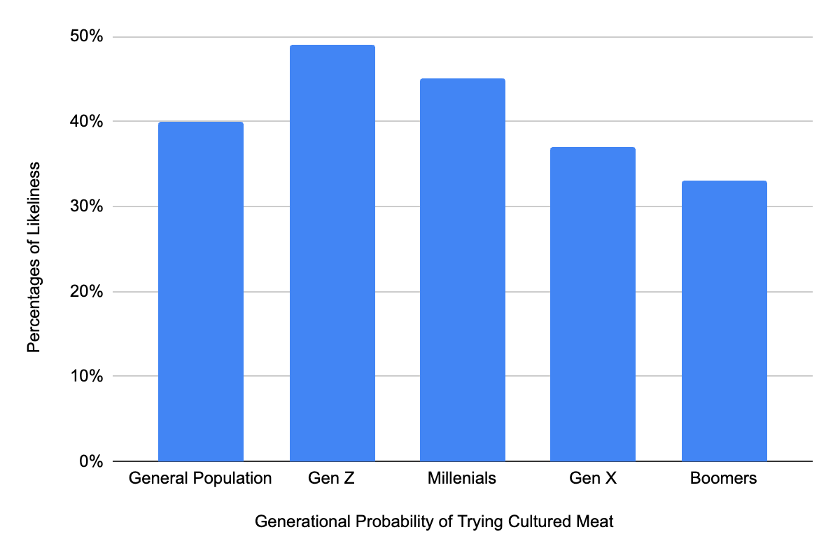
Opinions on Cultured Meat (Chart Made in Excel)
https://docs.google.com/spreadsheets/d/1QiT3-a3t6OC2AiskMcFcxKGsMaiuVNX4aEzVSxYStmE/edit?pli=1#gid=0
Notes:
As you can see, the newer generations are all willing to try cultivated meat. The majority of each generation are all willing to try or are considering.

Slide 8


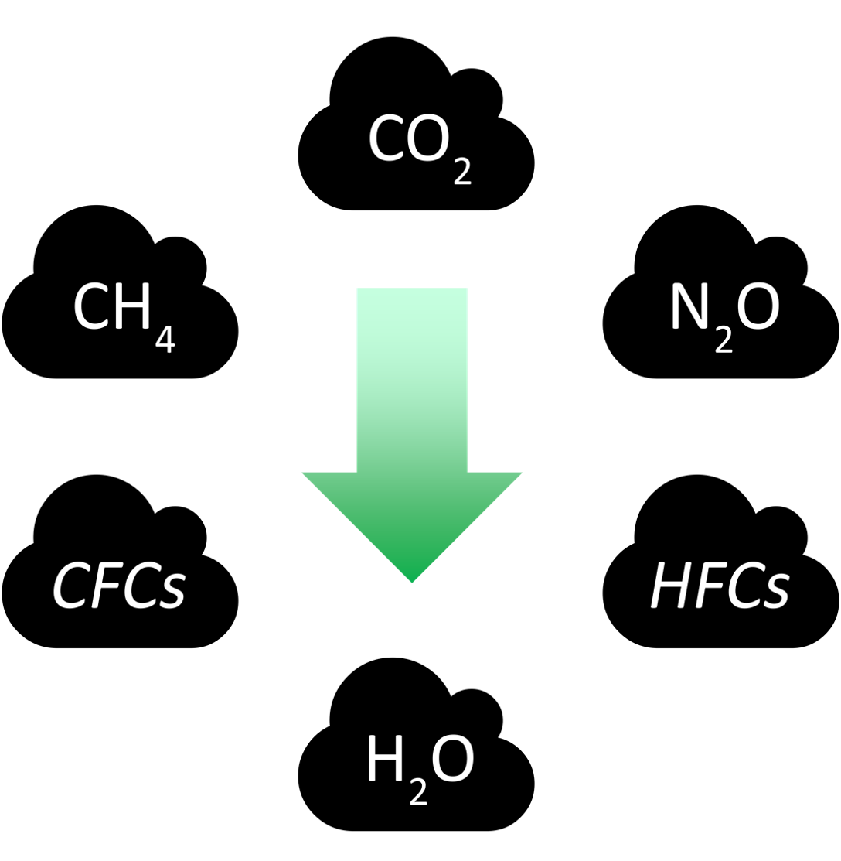
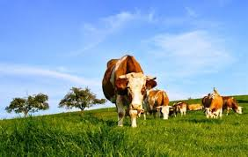


Success and Statistics
-Cultivated meat can cut down greenhouse gas emissions by 96%
-Can cut down water consumption by 82-96%
-1 pound of lab-grown meat can cost $17 dollars to produce
-The cultured meat market has been valued at 249 million USD and is estimated to grow 51% from there.
Notes:
Market continues to grow, and there are many positive benefits with this as well. However, there are downsides as well

Slide 9

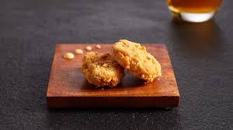
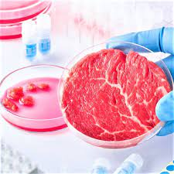
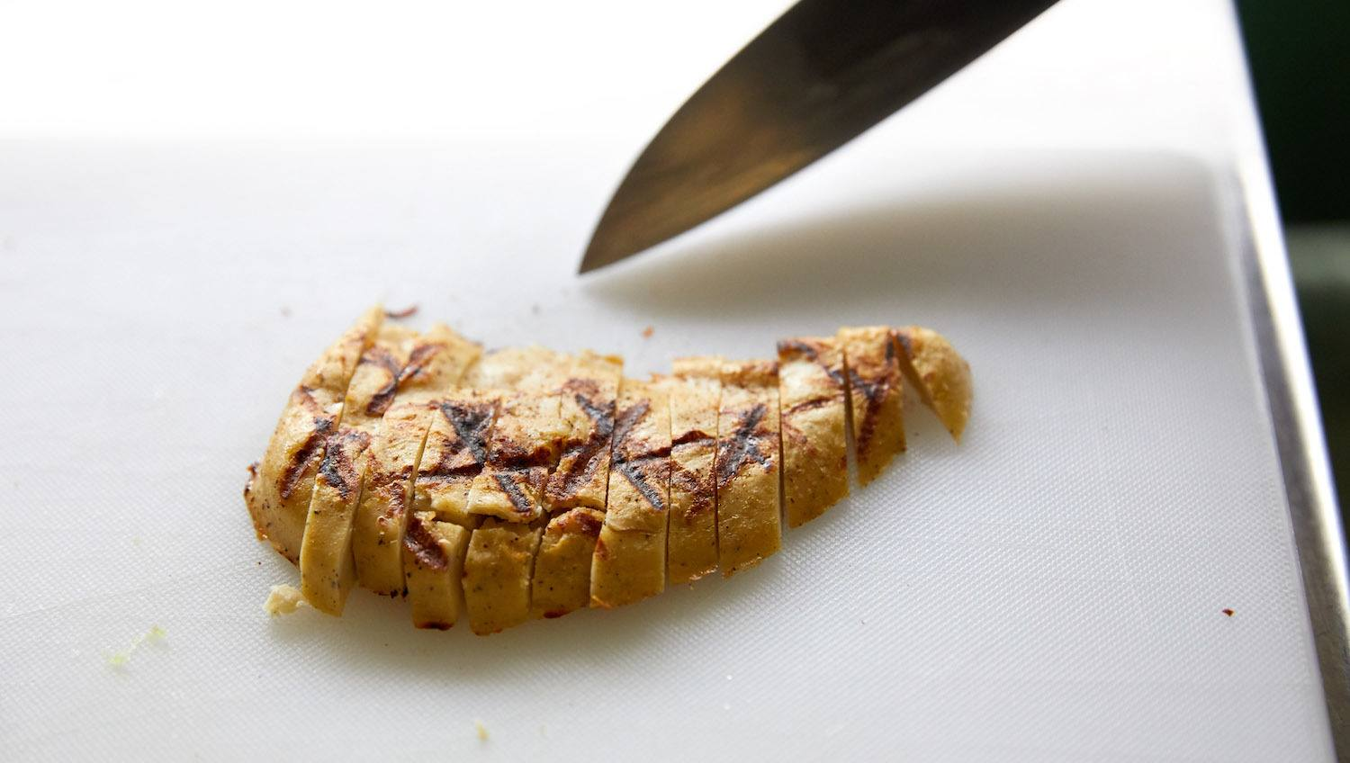
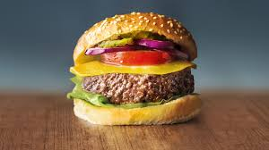

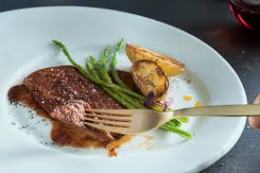
Summary
-In summary, I am for this advancement of cultured meat, due to the positive benefits it can provide. However, there were some moments where I would have been against cultured meat. Overall, I am for this advancement of technology.
Notes:
Positive benefits include efficiency, potential to be cheaper, and more environmentally/animal friendly. However some negatives were the price it took to produce

Slide 10
References
https://gfi.org/science/the-science-of-cultivated-meat/#:~:text=Dutch%20scientist%20Mark%20Post%20unveiled,cultivated%20meat%20companies%20were%20founded.
https://bioinformant.com/history-of-cultured-meat/
https://www.cnn.com/2022/06/06/health/lab-grown-meat-pros-cons-life-itself-wellness-scn/index.html#:~:text=In%20addition%20to%20mitigating%20animal,which%20are%20from%20animal%20agriculture
https://cms18.com/lab-grown-meat-pros-and-cons/
https://sentientmedia.org/lab-grown-meat/
https://www.foodnavigator.com/Article/2021/05/17/Cultivated-meat-likely-to-be-widely-accepted-by-the-general-public-especially-the-younger-generations-claims-start-up-after-study
https://www.colorado.edu/ecenter/2021/10/20/lab-grown-meat-emerging-industry#:~:text=Lab%20grown%20meat%20could%20cut,%25%2C%20depending%20on%20the%20animal.
Contact: ryanli9710@granitesd.org

